Slide 1

HACKRUSH - IIT GANDHINAGAR
QUANTITATIVE FINANCE: PORTFOLIO OPTIMIZATION CHALLENGE
Tejas Lohia
Md. Rehan Raza

Slide 2
Data
488 Large Caps of S & P 500

Slide 3
Table of Content
1 | Indicators used
2 | Other Parameters Used
3 | Strategy
4 | Risk Management
5 | Future Work

Slide 4
Indicators used
Moving Average
Relative Strength Index

Slide 5
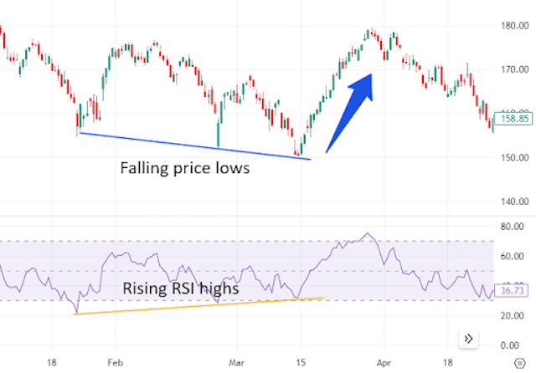
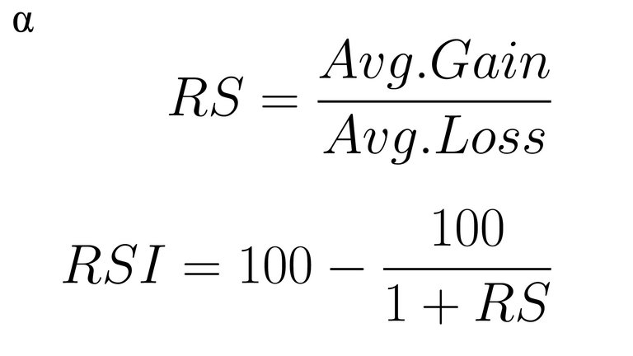
EMA
89
The Relative Strength Index (RSI) is a technical indicator that measures the strength and speed of a price movement to identify overbought or oversold conditions in a market.

Slide 6
EMA
89
The Relative Strength Index (RSI) is a technical indicator that measures the strength and speed of a price movement to identify overbought or oversold conditions in a market.

Slide 7
Other Parameters Used
1 | Average Returns, Annualized Returns
2 | Correlation
3 | Expected and Annual return of S&P
4 | Risk free rates, alpha and beta
5 | CAPM and Sharpe Ratio

Slide 8
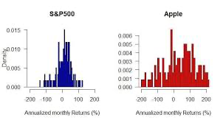
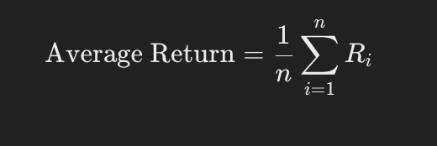
Average Returns
Average returns of stocks represent the mean gain or loss in value of a stock over a specific period, usually expressed as a percentage.

Slide 9
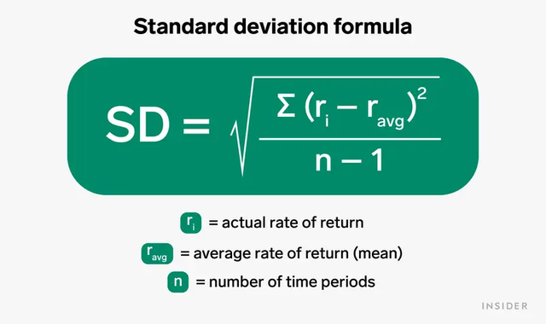
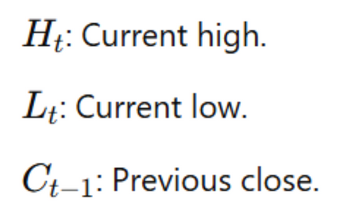
Annualized Return
Annualized Average Risk in the context of stocks refers to the typical level of variability or volatility in returns over a period. It helps investors understand how much the return on a stock deviates from its average return — essentially, how risky or stable the stock is.

Slide 10
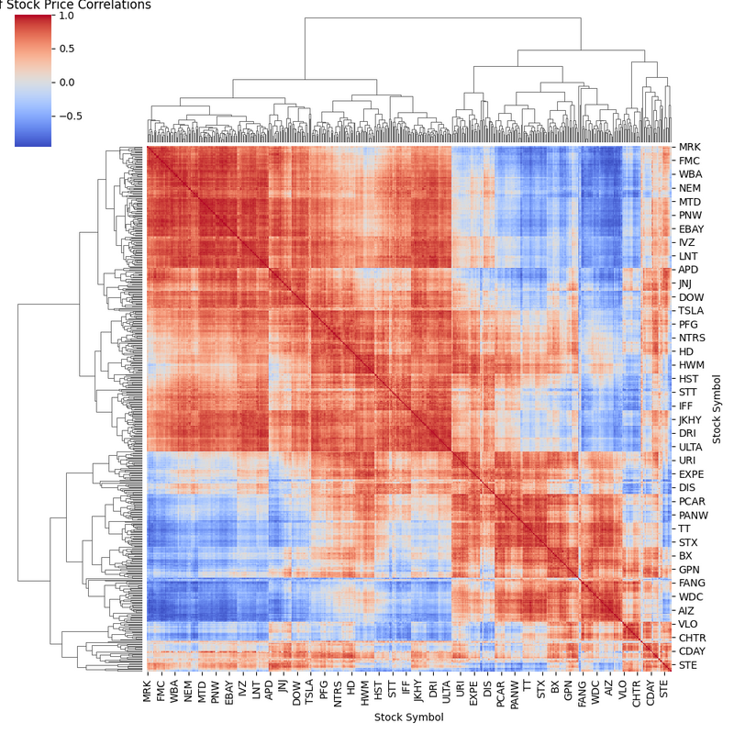
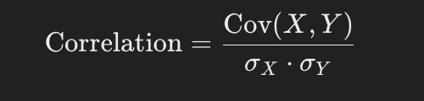
Correlation
Correlation measures the strength and direction of a linear relationship between two variables — in finance, usually between the returns of two stocks or assets.

Slide 11
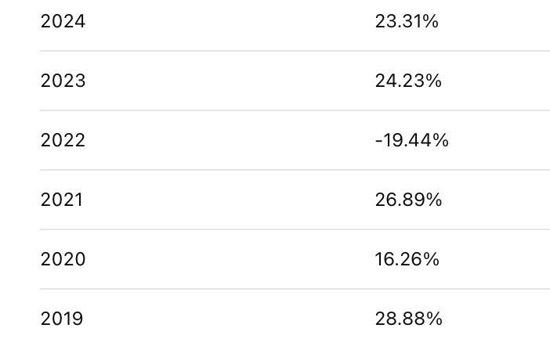
Important Data About S&P 500
The expected return of the S&P 500 is the average return investors anticipate from the index over a future period, based on historical performance or models like CAPM.

Slide 12
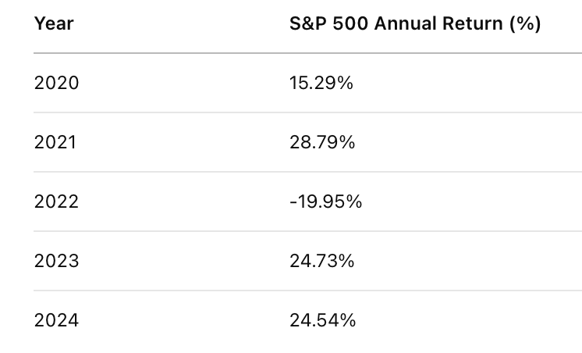
Important Data About S&P 500
The S&P 500 annual return refers to the percentage change in the value of the S&P 500 index over a year, including price appreciation and dividends

Slide 13
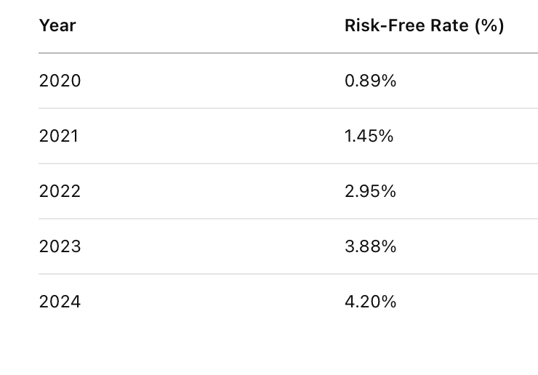
Risk Free Rates
The risk-free rate is the return expected from an investment with zero risk of financial loss, typically represented by government securities like U.S. Treasury bonds.
Used in models like CAPM to calculate the expected return of risky assets (e.g., stocks).

Slide 14
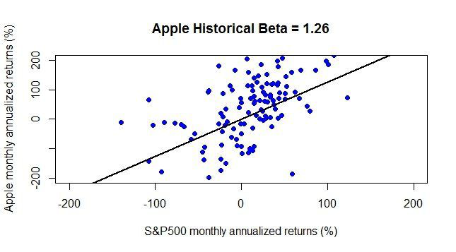
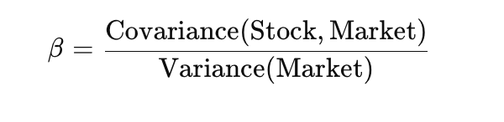
Beta (β)
Beta is a measure of a stock’s volatility relative to the overall market, typically the S&P 500. It tells you how much a stock is expected to move in relation to the market.

Slide 15
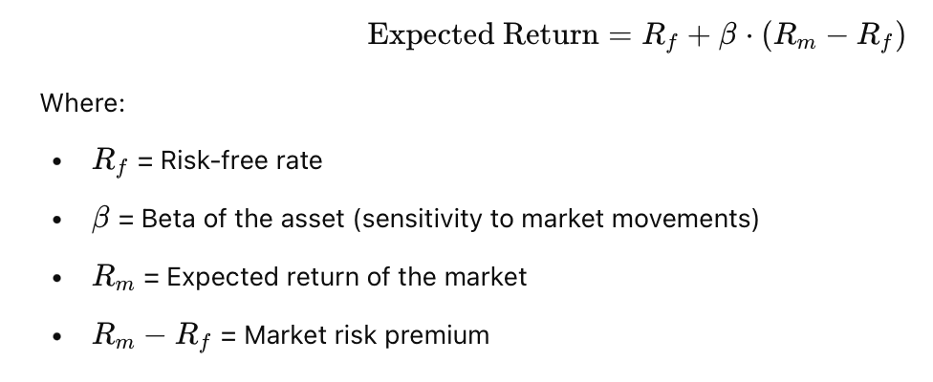
Expected Returns of Stocks
The Expected Return uses the Capital Asset Pricing Model (CAPM) to estimate the expected returns of a stock or portfolio based on its risk (beta), the risk-free rate, and the market return

Slide 16
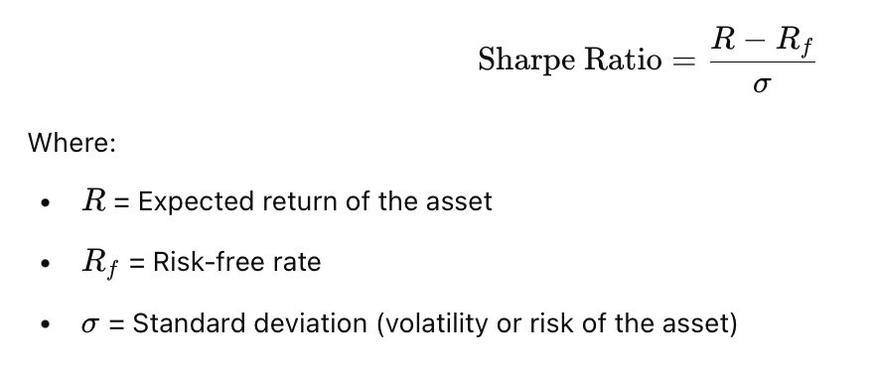
Sharpe Ratio
The Sharpe Ratio is a measure of risk-adjusted return. It tells you how much excess return you get per unit of risktaken.

Slide 17
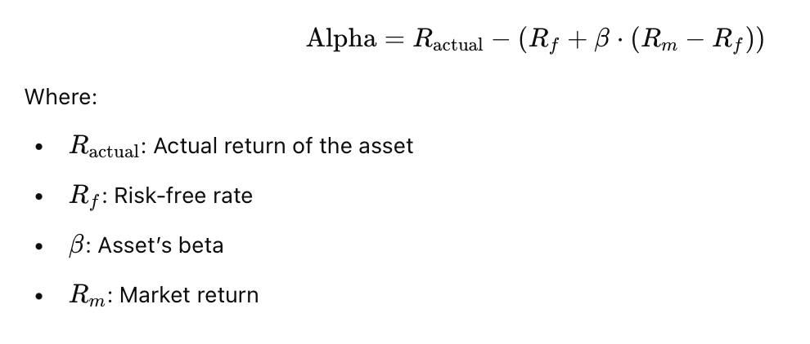
Alpha
Alpha measures the excess return an investment generates beyond what is predicted by the Capital Asset Pricing Model (CAPM).

Slide 18
Strategy
(1) Technical Indicators
This strategy operates on a 1-day timeframe and combines Moving Average for the last 50 days
trend identification and Relative Strength Index <= 30
Potential Signal: Closing price crosses above the MA5 and RSI <= 30

Slide 19
Strategy
(1) Modern Portfolio Theory Based
We used the Capital Asset Pricing Model (CAPM) to evaluate the expected returns of individual stocks based on their systematic risk, represented by beta.
The model helps quantify the return an investor should expect for taking on additional market risk, above the risk-free rate (Rf)
Specifically, we screened stocks with a beta greater than 1
Expected return (as per CAPM) greater than 12%
Risk < 20 Percent

Slide 20
Ensuring Minimum Portfolio Size – Soft Forcing Strategy
Our strategy includes a soft constraint to ensure that at least 20 stocks are selected each day
If Count < 20: Search among the remaining stocks for Lowest RSI Highest (Price − MA50)
Expected return (as per CAPM) greater than 12%
Risk < 20 Percent

Slide 21
Weight Allocation
We use pypfopt Library for Frontier Optimization and hence the weight allocation
Used Calculations Expected Returns Covariance Matrix (Σ) Efficient Frontier: Based on CAPM theory Optimization Goal – min_volatility() Weight Cleaning – clean_weights()
Expected return (as per CAPM) greater than 12%
Risk < 20 Percent

Slide 22
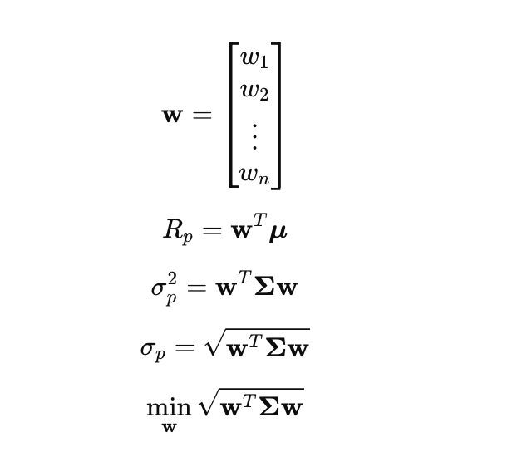
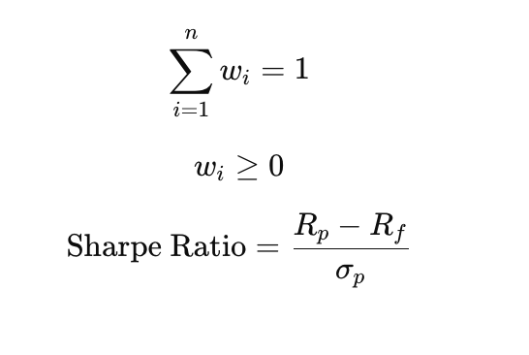
Background Optimization

Slide 23
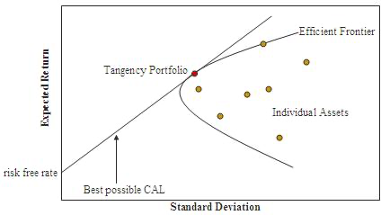
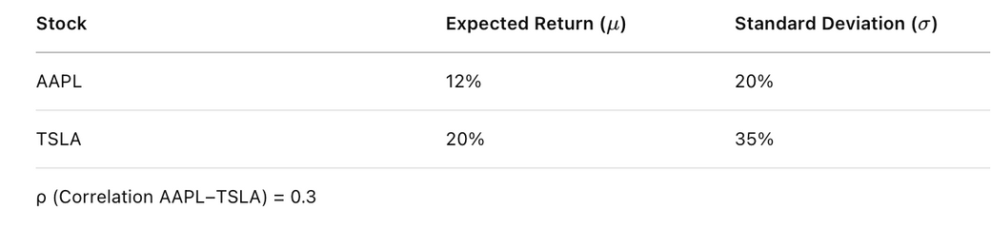
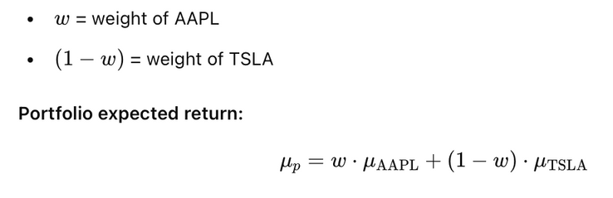
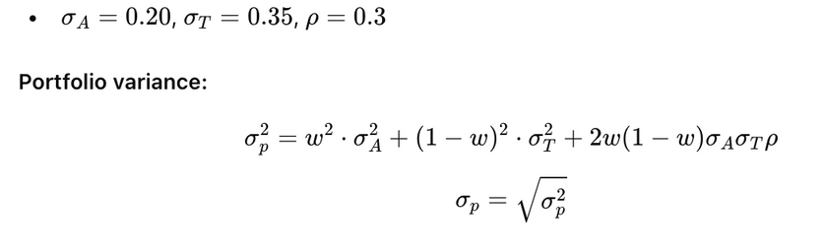
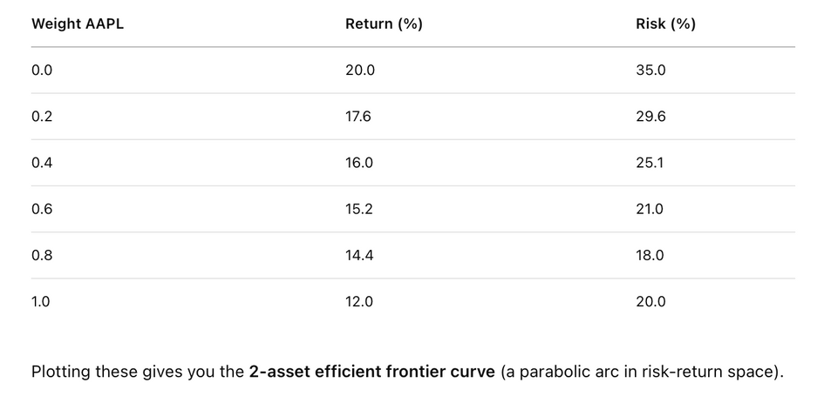
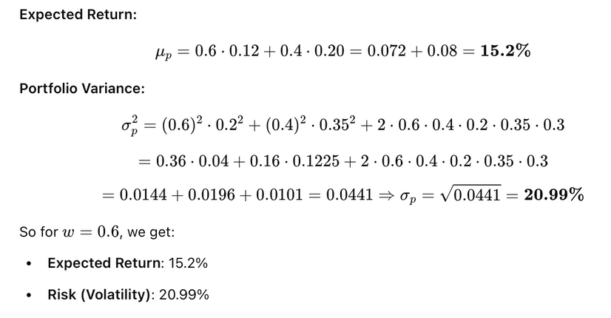
Efficient Frontier

Slide 24
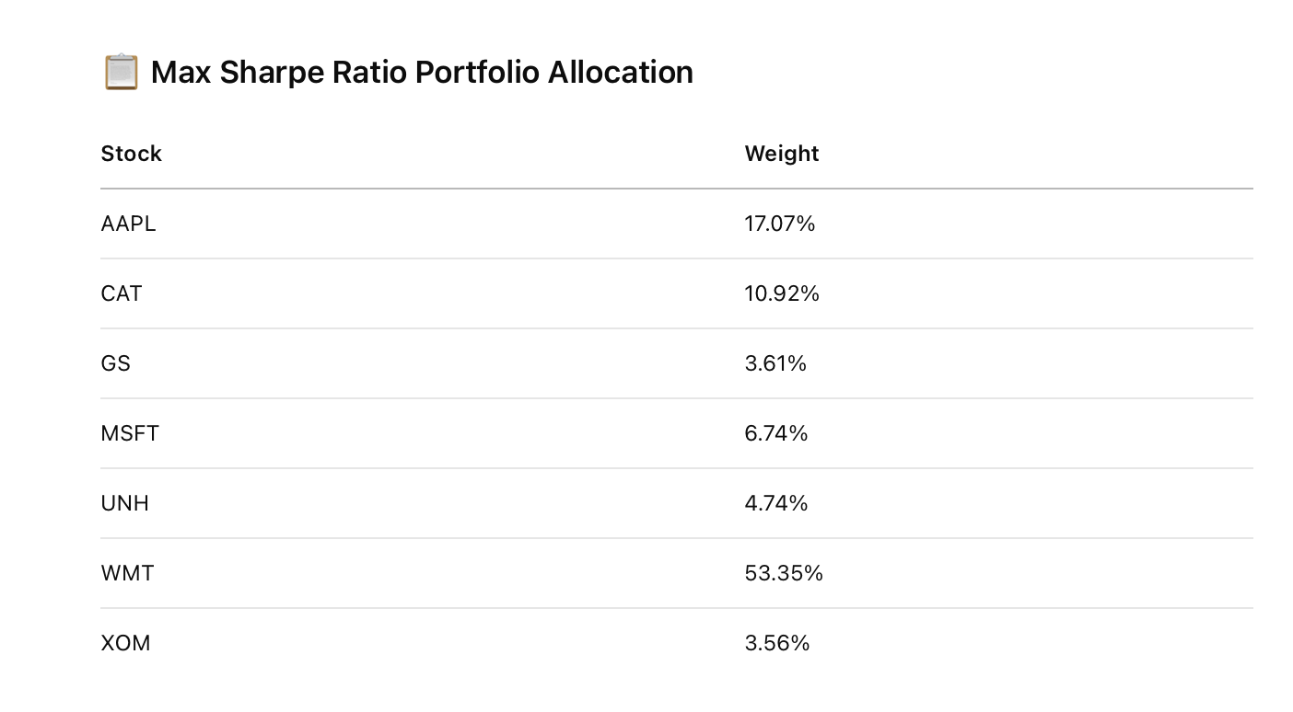
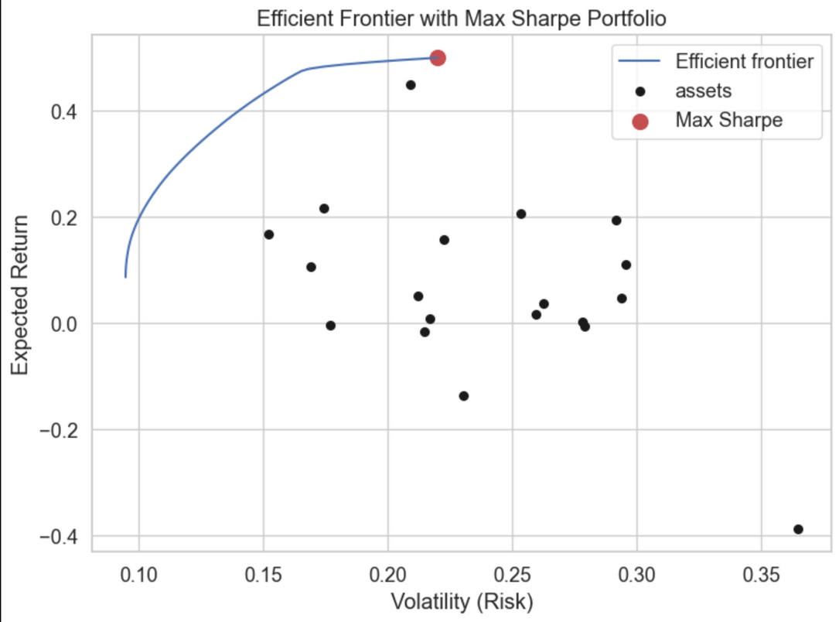
Result on some of the stocks returned by Stock selector
tickers_ret = ["AAPL", "DVN", "GOOGL", "TROW", "JPM", "BAC", "GS", "JNJ", "PFE", "UNH",
"PG", "KO", "WMT", "XOM", "CVX", "BA", "CAT", "VZ", "T", "DUK"]

Slide 25
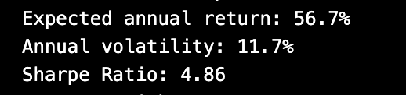
Result on some of the stocks returned by Stock selector
tickers_ret = ["AAPL", "DVN", "GOOGL", "TROW", "JPM", "BAC", "GS", "JNJ", "PFE", "UNH",
"PG", "KO", "WMT", "XOM", "CVX", "BA", "CAT", "VZ", "T", "DUK"]

Slide 26
Thank you!

